Slide 1
MUSIC PLAER
USING PYTHON

Slide 2
INTRODUCTION
Overview:-
The saying was indeed true, we all love music also we don’t prefer any kind of disturbance or adds in between but seems impossible without a paid subscription, so let’s try to design a music player, just like the way we want.
Music washes away the dust of everyday life from the soul.
We need an application that will allow us to play music or listen list of music. So, music player is the device that play music for user and provides a simple way to start it like its give play/stop button , volume buttons, forward and backward button. Also display different songs name , albums of songs and artist playlist. It’s easy to use and have a interactive interface.

Slide 3
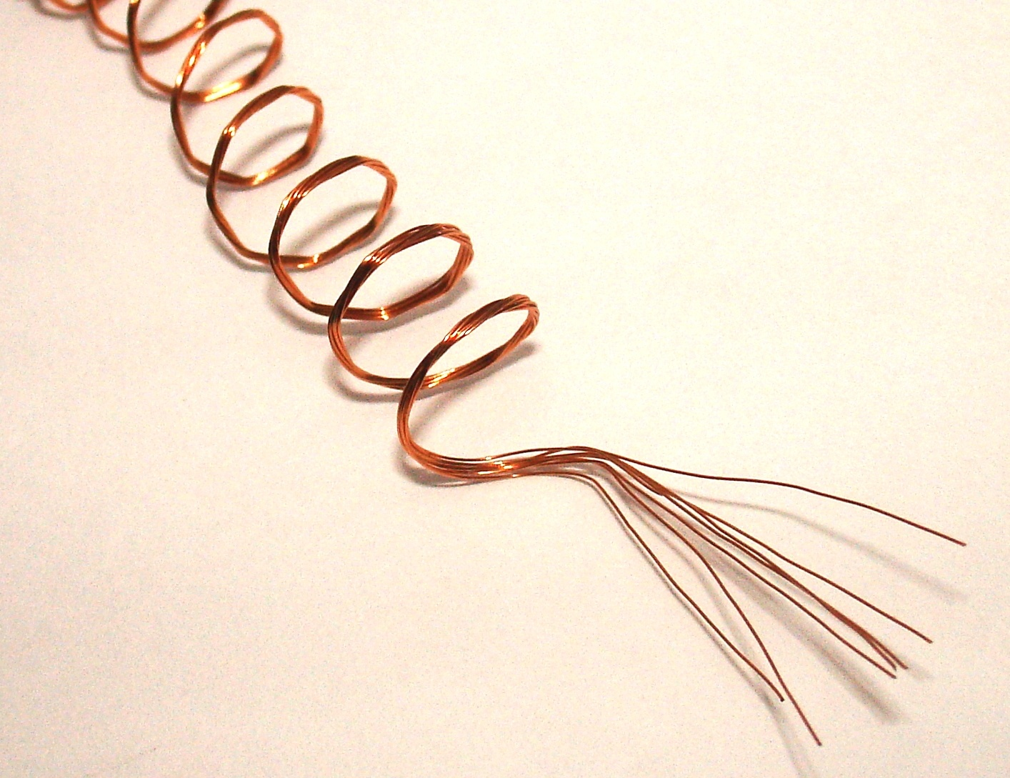
KEY FEATURES
PLAY
PAUSE
STOP
REWIND
MUTE
INCREASE OR DECREASE VOLUME
LOOP PLAY
CREATION OF OWN PLAYLIST

Slide 4
FLOW CHART
Choice one of displayed message
Start
Display list of songs,albums and artist icons
‘Choice one’ you want to start or exit
YES
Click on paly button to play, click on up to increase volume similarly to decrease and select to create own albums.
NO
You are out of app
END

Slide 5
TECHNOLOGY USED
SOFTWARE
HARDWARE
Python latest version
Or visual studio(vs) code
Mysql
8GB RAM
Intel cori5 processor

